Slide 1
TCSG’s Early Alert Management System ~ TEAMS
Dr. Nimisha Raval
Data, Planning, & Research

Slide 2
TEAMS Training Agenda
Overview
Configuration
Nuts & Bolts
Questions

Slide 3
TEAMS
Technical College System of Georgia’s Early Alert Management System also known as TEAMS
A collaborative web-based early intervention referral process designed to identify and sustain students who may be at-risk of attrition

Slide 4
TEAMS Objectives
Systematic approach to avail faculty and staff to collectively communicate and provide tools to generate successful and measurable outcomes in student achievement
Systemic process to benefit colleges in creating and modifying their operational methodology to retain and divert at-risk students towards successful completion

Slide 5
TEAMS Goal
Enhance academic performance, retention, and on-time degree completion
Identify students who may be at-risk for course completion possibly early in the semester
Provide avenues of internal and external support to the student

Slide 6
TEAMS - Phase I
Incorporate manual alerts submitted by full-time faculty with respect to:
Academic Concerns
Attendance Issues
Personal Hardships
Withdrawal from all courses
(especially at the beginning of the term)
General alert for selective areas

Slide 7
Which Students are At-risk?
Students who…
Are not attending the enrolled class regularly
Are present for less than 50% of class time
Are struggling academically
Are encountering personal hardships that are beyond their realm of control
Are in need of academic and non-academic supportive resources to succeed
Are overall less likely to do well in the registered course

Slide 8
Alert Process
Submitted alert gets automatically routed to the appropriate team
Designated personnel in the team will be able to:
Connect student to available resources for academic advancement
Communicate with student, faculty, and other areas of the college
Administer appropriate interventions
Generate effective educational pathways
Alert submitter can track alert progress, communication, intervention, and resolution

Slide 9
TEAMS Technicalities
Available at URL: https://teams.tcsg.edu/ while training site URL is: https://kmstrn.tcsg.edu/TEAMS
Web-based application resides in existing Knowledge Management System (KMS) environment so users have a single sign-on
Users categorized as Super User, Personnel User, or View-Only User
User management, alert routing, and intervention inclusion controlled and customized by individual colleges
Reports availability to assess application usage

Slide 10
User Management
Super User
Has full control of all the alerts and responsible for managing the TEAMS application, interventions, and functional teams
Personnel User
Has the capability to update only the alerts assigned to them or to their team
View Only User
Has the ability to merely view but not update any of the submitted alerts

Slide 11
TEAMS Modules
TEAMS
Alerts
Submit Alert
Reports
TCSG Admin
College Admin

Slide 12
College Admin
College Admin module allows colleges in personnel assignment to one or more functional teams, alert delegation to particular functional team, decision of one or more email address utilization for communication, and overall management of interventions
Student Navigator is responsible for managing the College Admin module

Slide 13
College Admin Continued
Four sub-modules comprised to achieve the aforementioned tasks are:
Manage Personnel
Route Alerts
Settings
Interventions Management

Slide 14
College Admin – Manage Personnel
Lists user Banner identification, full name, email address, phone number, primary PAS grouping, and functional team information
Enables allocation and modification of user PAS grouping and functional team

Slide 15
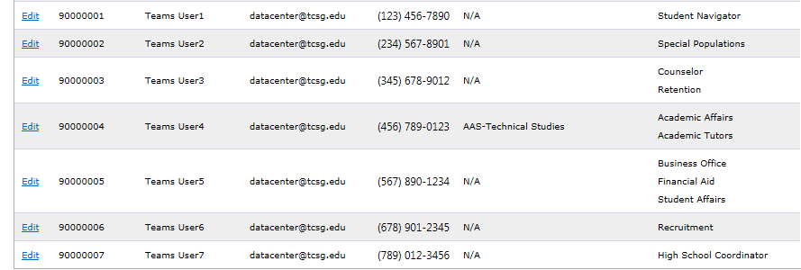
College Admin – Manage Personnel Continued

Slide 16
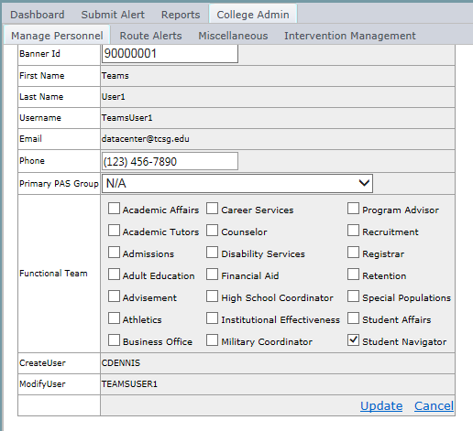
College Admin – Manage Personnel Continued

Slide 17
College Admin – Route Alerts
Enables alert priority status set-up of high, medium, or low
Enables functional team routing
Enables high school, military, and disability routing override selection

Slide 18
College Admin – Route Alerts Continued

Slide 19
College Admin – Settings
Enables student communication set-up to college provided email address or all available email addresses in Banner
Requires specification of student email domain for communication to student college email address ONLY

Slide 20
College Admin – Settings Continued
Enables student communication set-up to college provided email address or all available email addresses in Banner
Requires specification of student email domain for communication to student college email address ONLY

Slide 21
College Admin – Settings Continued

Slide 22
College Admin – Interventions Management
Interventions are action-oriented methodologies that can be recommended to the student for successful academic progression
Enables intervention selection set-up pertinent to college e.g. ABC college writes "Referred student to contact the academic tutors in Academic Achievement Center for content reinforcement" while XYZ college writes "Referred student to contact the academic tutors in Tutoring Labs for content reinforcement".

Slide 23
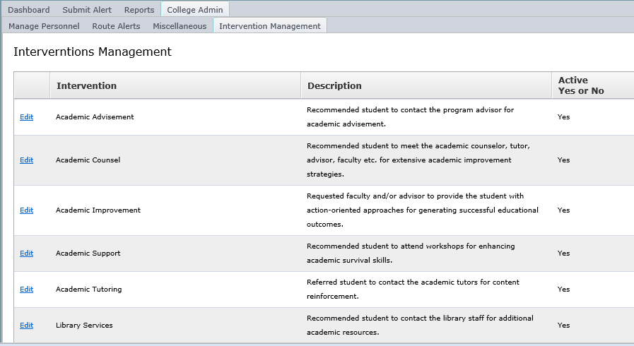
College Admin – Interventions Management Continued

Slide 24
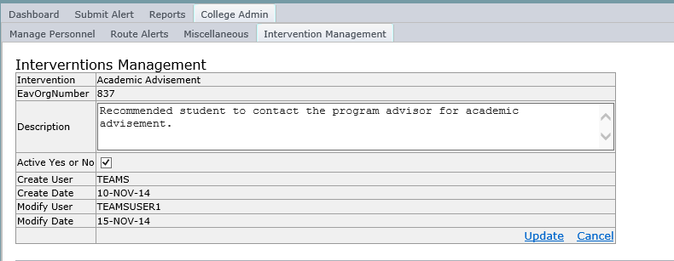
College Admin – Interventions Management Continued

Slide 25
Submit Alert
Alerts can be submitted by any TEAMS user to help students in addressing the challenges that can affect their enrollment and continuation at the college
Alert submitter will ideally choose one of the available descriptive alert types
Alert submitter should include any steps that have already been taken to help the student

Slide 26
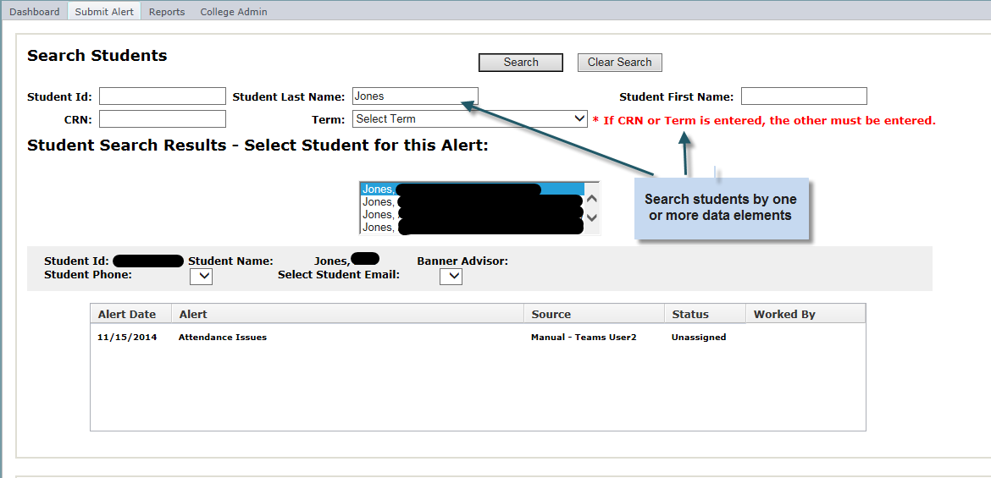
Submit Alert – Scenario I

Slide 27
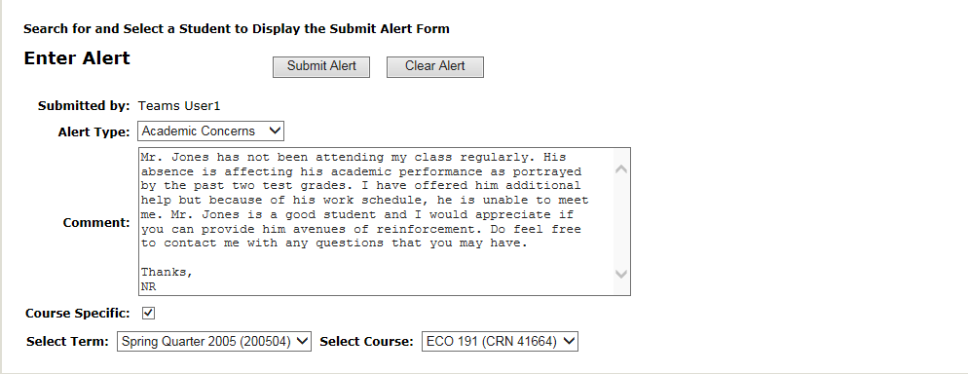
Submit Alert – Scenario II

Slide 28
Alerts
Upon TEAMS logon, user is diverted to the Alerts interface and everything with respect to any alert is available in this module
Four components in Alerts module are:
Alert Listings
Alert Details
Communications
Interventions

Slide 29
Alerts - Alert Listings
Default component of Alerts to display all open alerts assigned to the user and unassigned to the user’s team
Enables additional alert search functionality by multiple fields, unread messages, and alerts submitted by the user

Slide 30
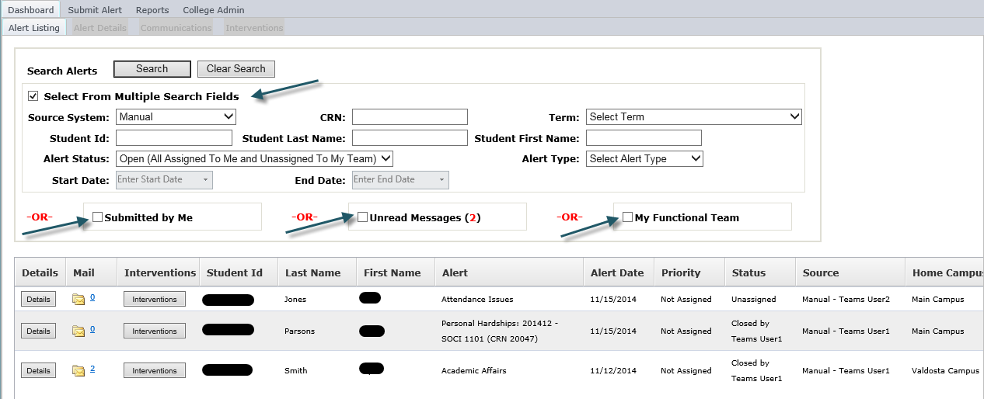
Alerts - Alert Listings Continued

Slide 31
Alerts - Alert Details
User can find details of an alert by clicking on “Details” button on Alerts or clicking on the sub-module Alert Details after student selection
Displays relevant student specifics such as:
* Id, full name, email address, phone number, and program of study information
* Alert history
* Academic history
* Placement test history

Slide 32
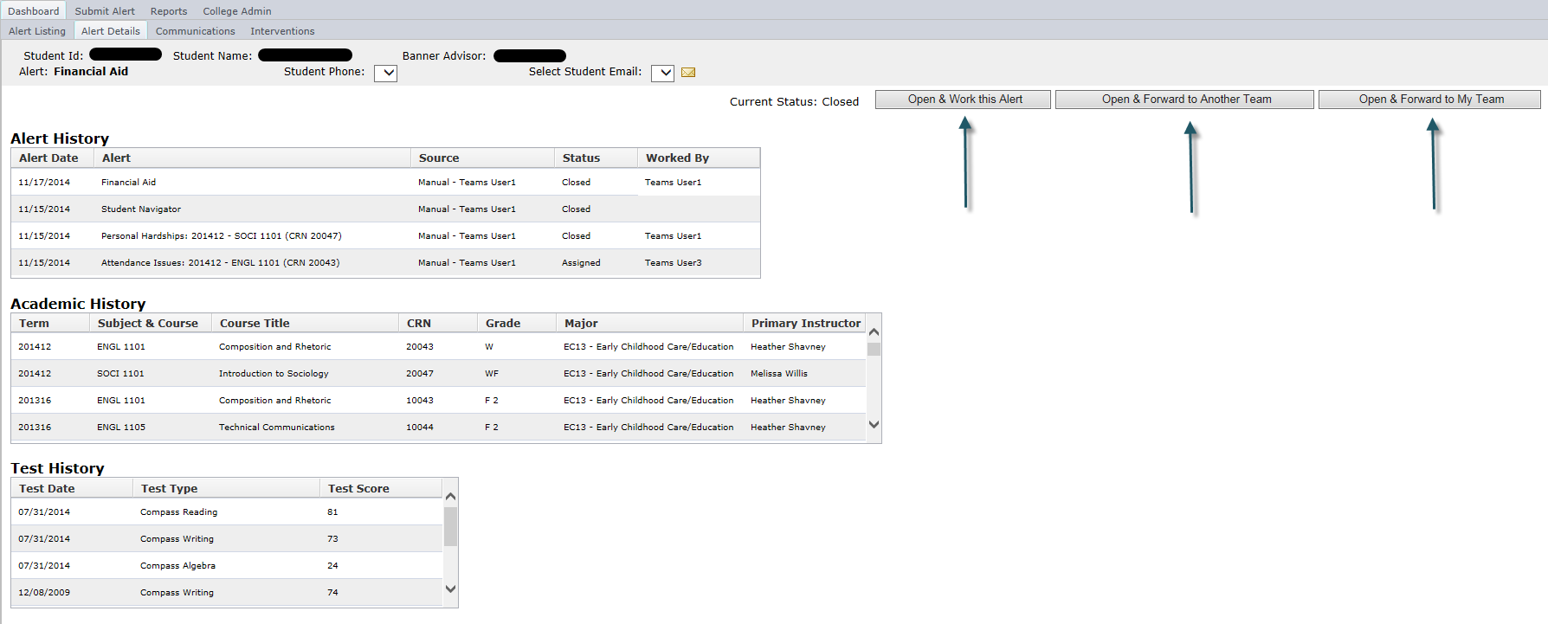
Alerts - Alert Details Continued

Slide 33
Alerts - Communications
Email interface utilized to generate communication with the student with the ability to note comments
Capability to mark a checked email as Private for sensitive information
Recommendation for users to be cognizant of Family Educational Rights and Privacy Act and Open Records Act stipulations

Slide 34
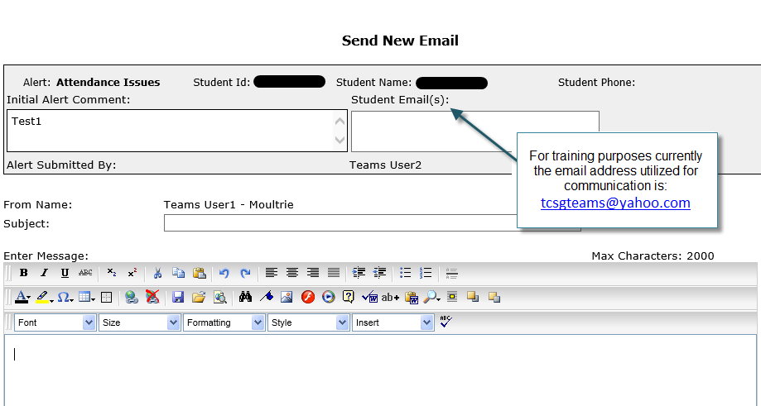
Alerts – Communications Continued

Slide 35
Alerts - Interventions
Interventions are proactive processes that can be administered for each alert
Alert can be closed in this sub-module
Documents student contact attempts and modes of contacts
Registers successful or unsuccessful student contact
Notes mandatory comments for alert closure

Slide 36
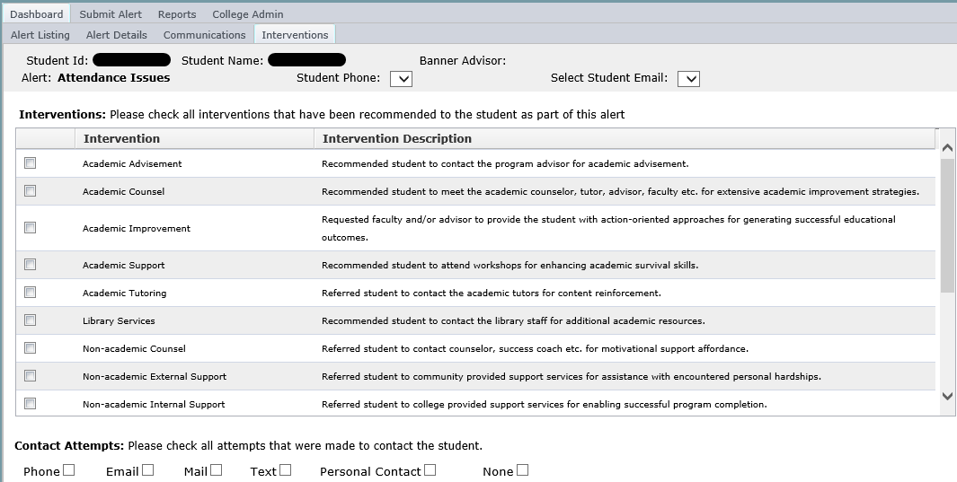
Alerts – Interventions Continued

Slide 37
Reports
Enables the college to get an idea about the total number of alerts explicit to various alert categories, intervention types, college divisions, and functional teams
Provides ability to design and develop strategies to better student learning experience as well as manage the alerts and interventions optimally
Act upon evident gaps with respect to referrals and interventions directed for these referrals by quantifiable outcomes data

Slide 38
TEAMS Necessitations
Best practices recommendations for successful conclusion:
Faculty should be strongly urged to submit a referral as soon as the situation occurs
Staff should provide students with options to address and resolve the issue, better the outcomes, and in turn positively affect the retention and completion rates at the college
Student Navigators should periodically assess the operative processes and modify as warranted
Executive teams should emphasize TEAMS’ role in completion agenda

Slide 39
TEAMS Necessitations Continued
Prior to implementation, colleges will have to:
Decide TEAMS users, access levels, and team placement
Define routing for all alerts
Distinguish routing for alerts involving special needs students
Describe various interventions for all alerts
Determine and train Learning Support faculty
Delineate overall operational implementation

Slide 40
TEAMS Questions
Contact: Datacenter@tcsg.edu

